Slide 1
Test Automation JSON as a Data Source
Jared Sheffer

Slide 2
What is JSON?
JSON (JavaScript Object Notation)
Data format - easy for humans/computers to read and manipulate
Follows a Key, Value structure

Slide 3
What is JSON?
Key : Value
Must be a pair
Keys must be unique
Example → “username” : “test_user1”, “password” : “tropical1”
Key-Value pair must be within braces { }
Example → { “username” : “test_user1”, “password” : “tropical1”}

Slide 4
What is JSON?
Key – Must be string
Value – must be string, number, array, Boolean or json object

Slide 5
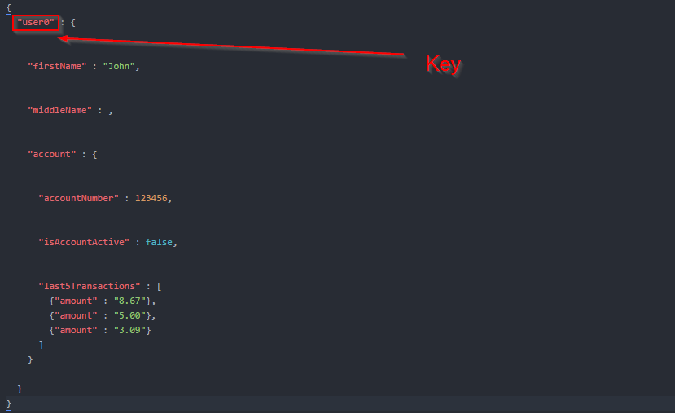
JSON Example

Slide 6
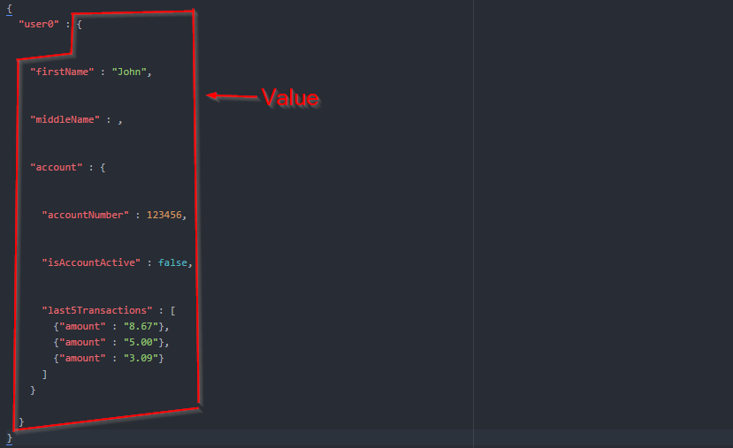
JSON Example

Slide 7
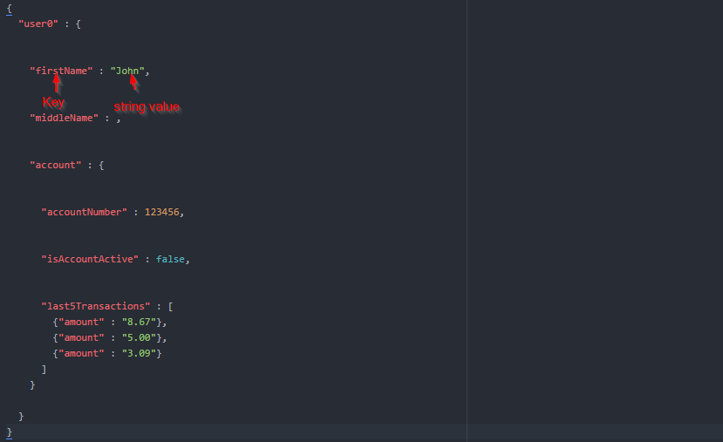
JSON Example

Slide 8
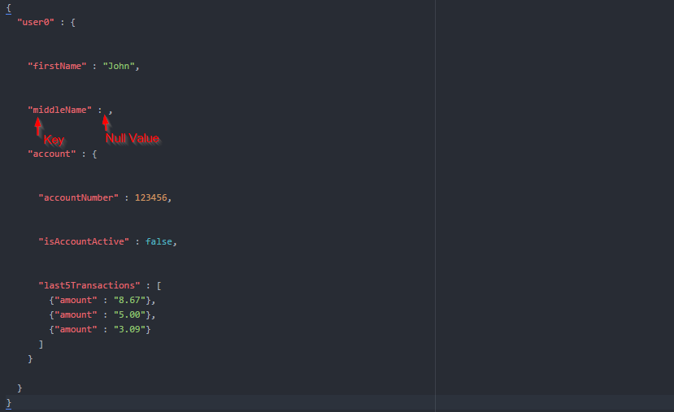
JSON Example

Slide 9
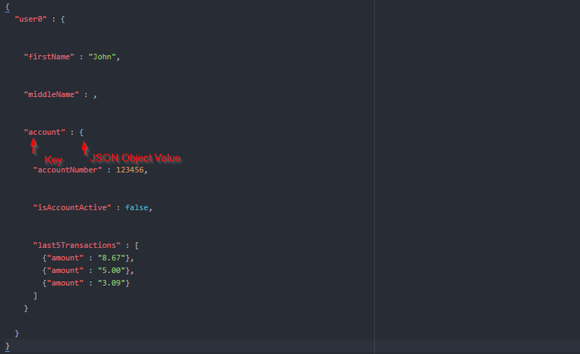
JSON Example

Slide 10
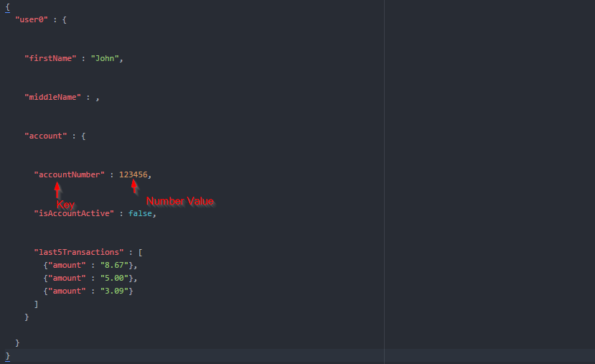
JSON Example

Slide 11
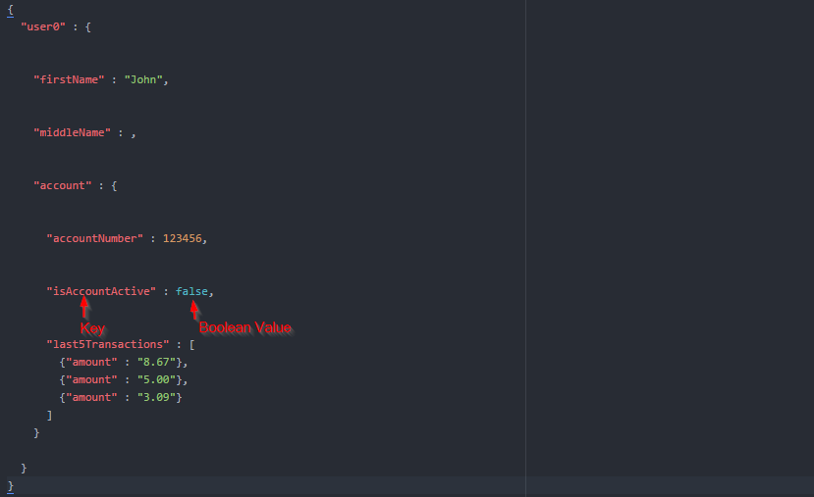
JSON Example

Slide 12

JSON Example

Slide 13
JSON Example

Slide 14
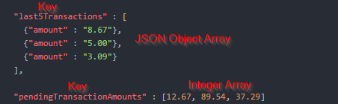
JSON Example

Slide 15
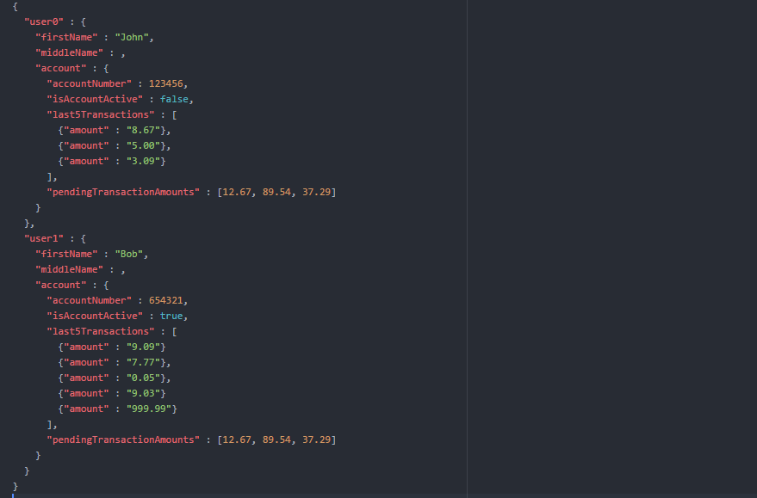
JSON Example

Slide 16
Questions?

